Slide 1

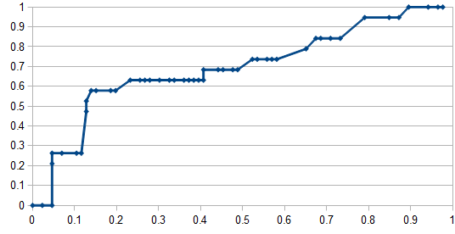



Mining Progress Notes for Prediction of Activities of Daily Living
RESEARCH AND EDUCATION IN MACHINE LEARNING
TALHA OZ, CHE NGUFOR, JANUSZ WOJTUSIAK
Center for Discovery Science and Health Informatics, George Mason University, Fairfax, VA
INTRODUCTION
In healthcare, activities of daily living (ADLs) describe a set of measurements for evaluating a person’s independence and capability in performing various activities related to normal life. It is particularly important when evaluating elderly and disabled.
Computational scientists and clinical practitioners exploit the electronic health records to analyze data and discover patterns. A dominant subset of EHRs data is unstructured clinical notes, which include wealth of information not available in coded form.
Most predictive n-grams for Bladder Control ADL | LR
kinesiotherapy progress standard kinesiotherapy ms | 14.2
impairment group 2SD0 brain dysfunction | 14.2
eud attached bsd draining yellow | 9.46
possible interventions va local gi | 9.46
ROC Curve for Bladder Control ADL
OBJECTIVE
This research focuses on finding a method for accurately predicting a particular ADL status of a patient (test case) given a set of progress notes. To do so, models are learned from progress notes representing patients with known values of ADL, as measured by Barthel indices assessed by clinicians.
True positive rate
DATA
False positive rate
The data included 1045 labeled progress notes and 10-fold cross validation technique to test models. Models are learned for each activity from Barthel index separately.
The dataset is imbalanced: e.g. for Bladder Control ADL, about 776 of the training cases are negative and 164 of them are positive. Remaining 105 notes are used for validation.
Review & Future Work
The initial work explored several approaches based on likelihood ratios of n-grams. This has led to the observation of limitations related to the size of the dataset used. Also, the results have not been validated for clinical adequacy.
New features to be incorporated: part-of-speech (POS) from Stanford tagger, section information, word representations: LDA/LSI or Brown clustering, and semantic categories of words based on UMLS lookup, MetaMap or cTAKEs outputs.
Initial Experiments
In the pilot project presented here, N-grams which have high predictive power as measured by likelihood ratios, statistical significances and their expected values have been identified. Design of the system, and obtained classifier’s receiver operating characteristic (ROC curve) are presented below.
Sentence breaking (Stanford Core NLP)
Normalization of numeric values
Calculation of the likelihood ratios of the n-grams that appear in the test case
Replacement and removal filtering with help of subject-matter experts
Contiguous word n-gram generation
Deciding on the class based on the informative n-grams
ADL category | Status
Eating
Transferring
Grooming
Toileting
Bathing
Walking
Dressing
Bowel Incontinence
Bladder Control
Machine Learning and Inference Laboratory
College of Health and Human Services
www.mli.gmu.edu
4400 University Dr. MSN 1J3
Fairfax, VA 22030, USA

